Slide 1
Digital Nightlight
Dan McCreary

Slide 2
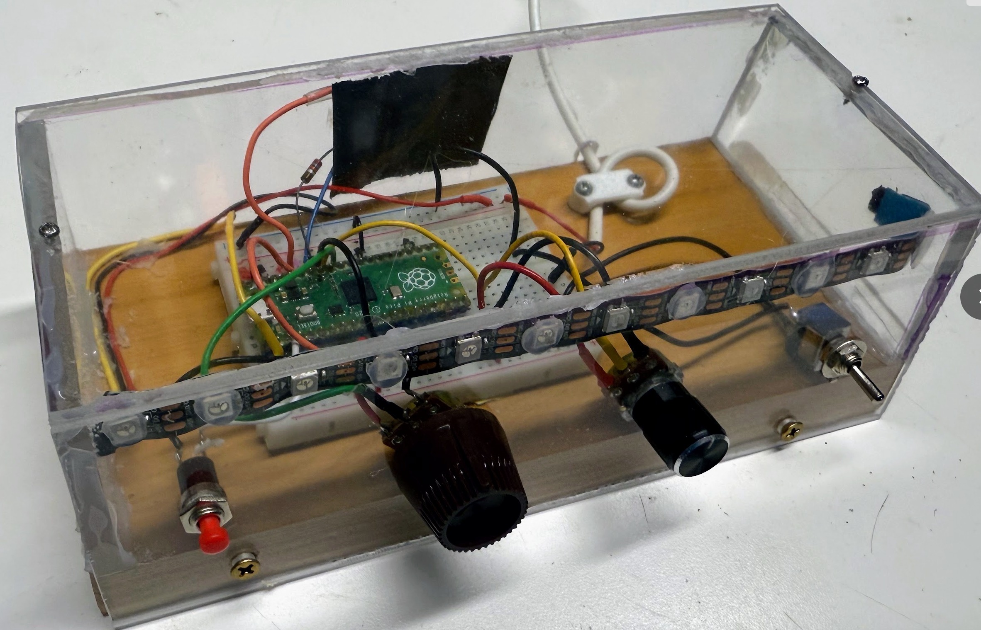
Light
Sensor
Power
Color
Mode
Brightness

